Slide 1
I Find Bugs too Boring to Write
Arlo Belshee
Tableau (we’re hiring)
@arlobelshee, github/arlobelshee

Slide 2

Bug Source 1: Illegible Code
This code you keep calling.
I do not think it means what you think it means.

Slide 3
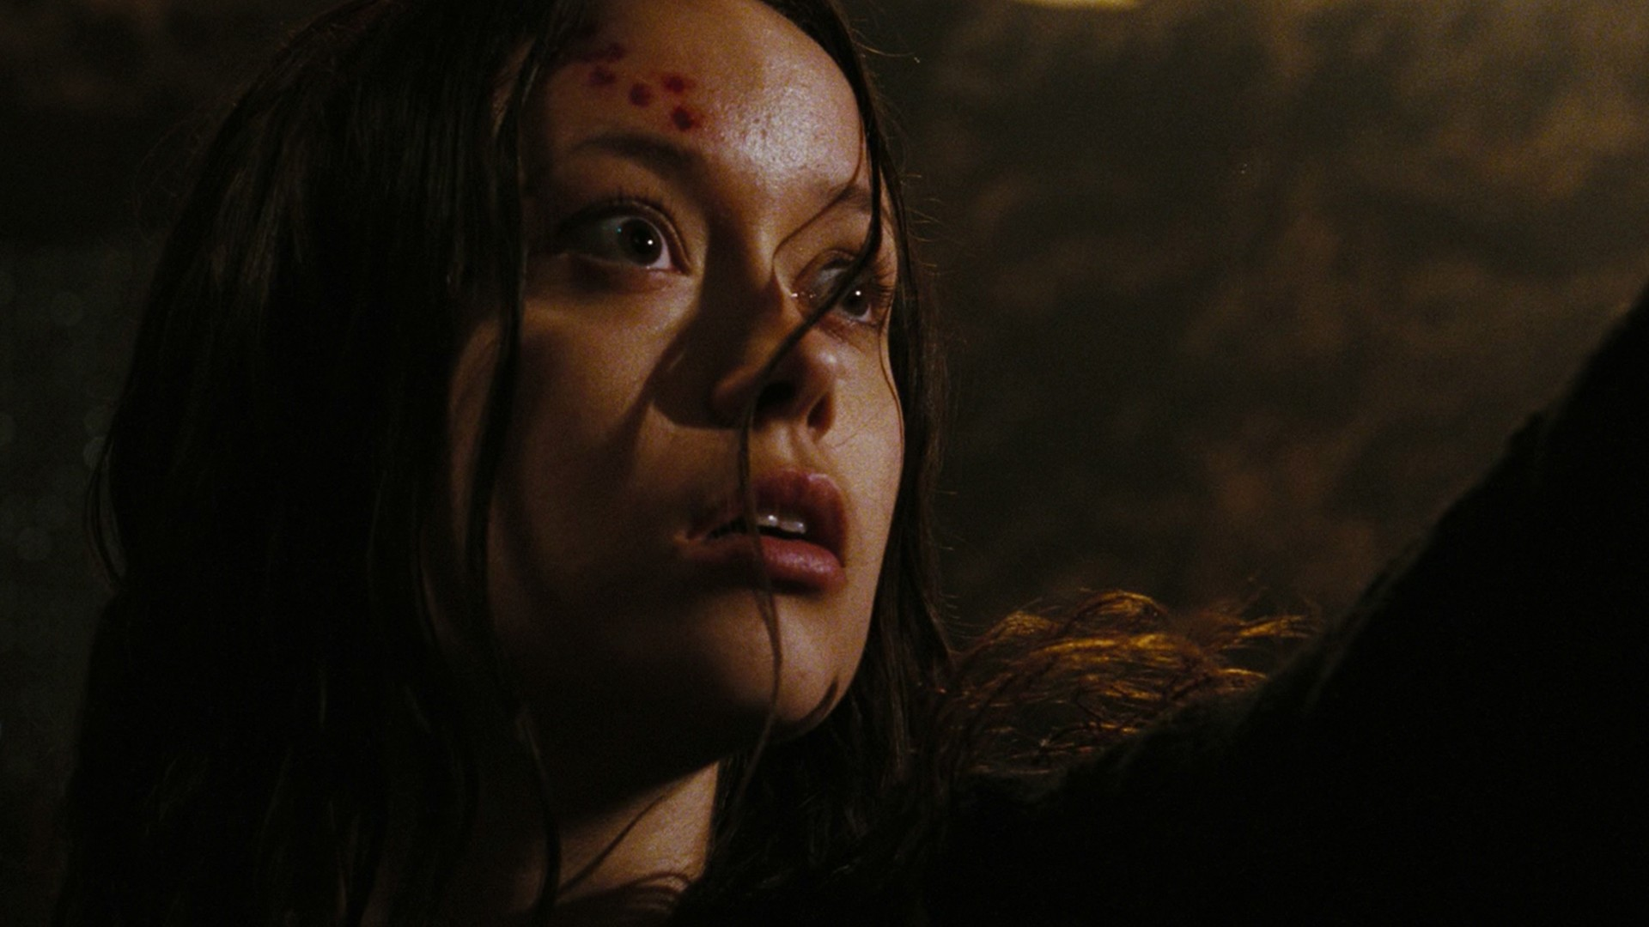
Bug Source 2: Unexpected Interactions
I think I swallowed a bug
Spooky Action at a Distance

Slide 4
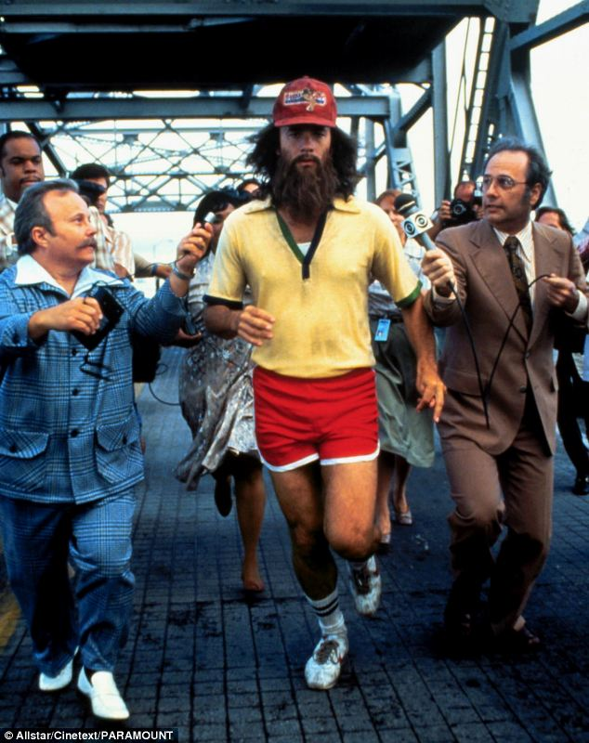
What about Architecture Flaws?
A journey of a thousand miles begins with a single step

Slide 5
I Find Bugs too Boring to Write
Arlo Belshee
Tableau (we’re hiring)
@arlobelshee, github/arlobelshee

